Slide 1

Computer Organization And Architecture
CSE-209
Lecture – 12
Al Bashir
Lecturer, Dept. of CSE
Dhaka International University

Slide 2
Content
Pipelining

Slide 3
Pipelining
Pipelining is a process of arrangement of hardware elements of the CPU such that its overall performance is increased. Simultaneous execution of more than one instruction takes place in a pipelined processor.

Slide 4
Pipelining : Understanding with example
Let us see a real life example that works on the concept of pipelined operation. Consider a water bottle packaging plant. Let there be 3 stages that a bottle should pass through, Inserting the bottle(I), Filling water in the bottle(F), and Sealing the bottle(S). Let us consider these stages as stage 1, stage 2 and stage 3 respectively. Let each stage take 1 minute to complete its operation. Now, in a non pipelined operation, a bottle is first inserted in the plant, after 1 minute it is moved to stage 2 where water is filled. Now, in stage 1 nothing is happening. Similarly, when the bottle moves to stage 3, both stage 1 and stage 2 are idle. But in pipelined operation, when the bottle is in stage 2, another bottle can be loaded at stage 1. Similarly, when the bottle is in stage 3, there can be one bottle each in stage 1 and stage 2. So, after each minute, we get a new bottle at the end of stage 3. Hence, the average time taken to manufacture 1 bottle is :
Without pipelining = 9/3 minutes = 3m

Slide 5
Pipelining : Operation Phase
Fetch Instruction (FI)
Decode Instruction (DI)
Calculate Operands (CO) (i.e. EAs)
Fetch Operands (FO)
Execute Instructions (EI)
Write Result / Operands (WO)
Overlap these operations

Slide 6
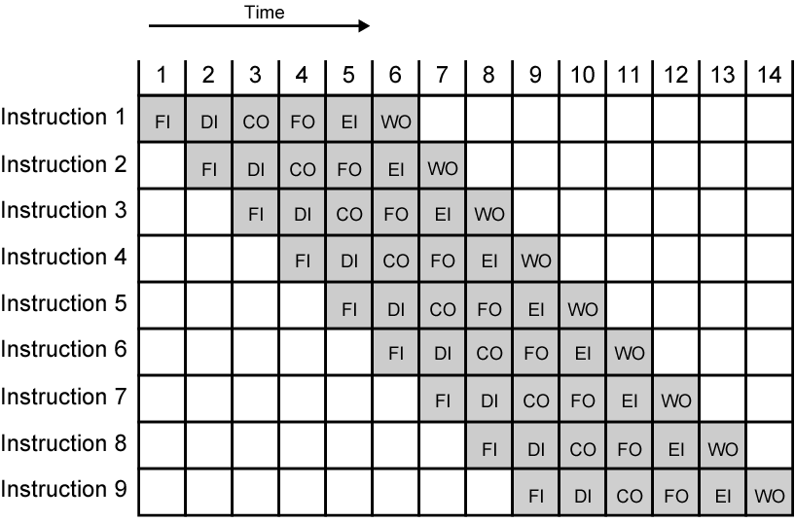
Timing Diagram for Instruction Pipeline Operation

Slide 7
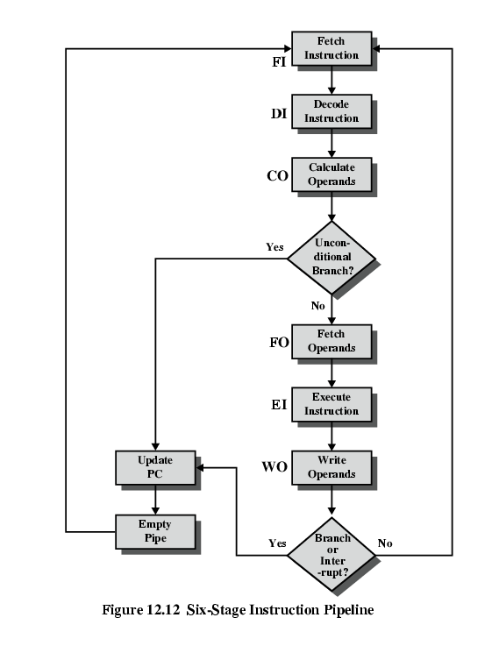
Six Stage Instruction Pipeline

Slide 8
Alternative Pipeline Depiction
In following Fig.(a) the pipeline is full at time 6, with 6 different instructions in various stages of execution, and remains full through time 9; we assume that instruction I9 is the last instruction to be executed.
In Fig.(b) the pipeline is full at times 6 and 7. At time 7, instruction 3 is in the execute stage and executes a branch to instruction 15. At this point, instructions I4 through I7 are flushed from the pipeline, so that at time 8, only two instructions are in the pipeline, I3 and I15.

Slide 9
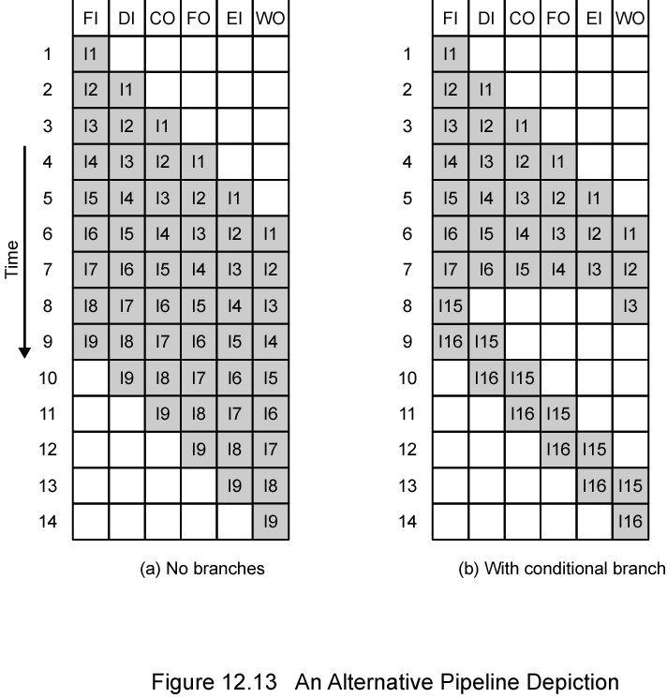
Alternative Pipeline Depiction

Slide 10
Question??

Slide 11
Thanks

